Slide 1
Computer Architecture and Organization
Instructor: Robert Utterback

Slide 2
Housekeeping
Syllabus/Webpage
Schedule
Notes
Assignments

Slide 3
Syllabus and Webpage
Course webpage: robertutterback.github.io/courses/comp230/f18/
Serves as syllabus and schedule
Assignments will be released there

Slide 4
Getting Help
Email
rutterback@monmouthcollege.edu
Office: CSB 342
Office Hours:
Mon & Fri: 9-10 AM
Tue and Wed: 3-4 PM
Thu 9-11 AM
By appointment (see my schedule at robertutterback.github.io/schedule/)

Slide 5
Grading
(7-8) Assignments: 35%
Some will include programming
HW 0 out now!
(3) Exams:
2 “midterms”: 15% each
Final: 25%
Participation: 10%
Notes:
Participation includes Socrative component and in-class activities
Explain HW 0…

Slide 6
Textbook
Computer Organization and Design: The Hardware/Software Interface, 5th Edition, by Patterson and Hennessy, Morgan and Kaufman Publishers, Inc., 2014
Notes:
I like its organization, though it has some errors, a few of them significant.

Slide 7
Tips for getting an A
Come to class
Ask questions and participate
Review your notes after class
Start the homework early
Come to office hours with questions
Notes:
I’ll post the slides every day after class, but really it’s better to take your own notes.

Slide 8
Advice from Previous Students
It would probably be useful to actually keep up with the readings of the textbook. If I were to take the course again I definitely would.
Be patient, and start early. Also make sure you ask for help. Professor is very friendly and patient and he can point you in the right direction.

Slide 9
Content
Chapters 1, 2, 3
Appendix B
Part of chapters 4 and 5
Briefly skim chapter 6

Slide 10
Why this course?
Foundation for Operating Systems
Understanding hardware makes you a better programmer
Lots of new hardware and devices
Even more important to know what’s going on “under the hood”
Notes:
I am teaching operating systems next semester…

Slide 11
Computer Evolution
Moore’s Law
The number of transistors that can be placed inexpensively on an integrated circuit doubles approximately every two years
For many years this also meant chip performance doubled every two years
No longer true!
Instead, add more cores.

Slide 12
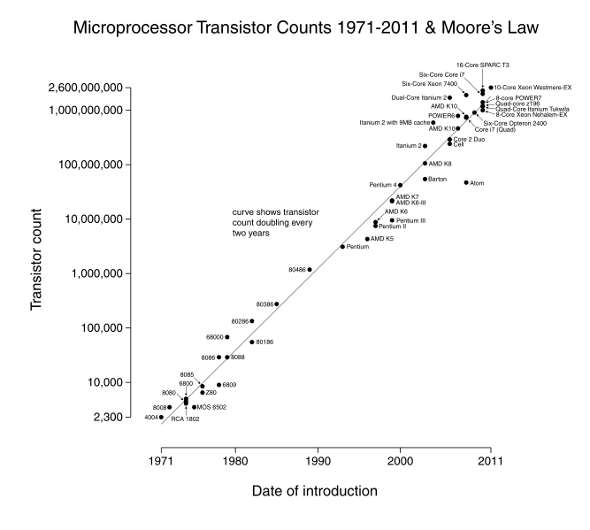
Moore’s Law
Notes:
Note the “logarithmic” scale…

Slide 13
The Computer Revolution
§1.1 Introduction
Progress in computer technology
Underpinned by Moore’s Law
Makes novel applications feasible
Computers in automobiles
Cell phones
Human genome project
World Wide Web
Search Engines
Computers are pervasive

Slide 14
Classes of Computers
Personal computers
General purpose, variety of software
Subject to cost/performance tradeoff
Server computers
Network based
High capacity, performance, reliability
Range from small servers to building sized

Slide 15
Classes of Computers
Supercomputers
High-end scientific and engineering calculations
Highest capability but represent a small fraction of the overall computer market
Embedded computers
Hidden as components of systems
Stringent power/performance/cost constraints

Slide 16
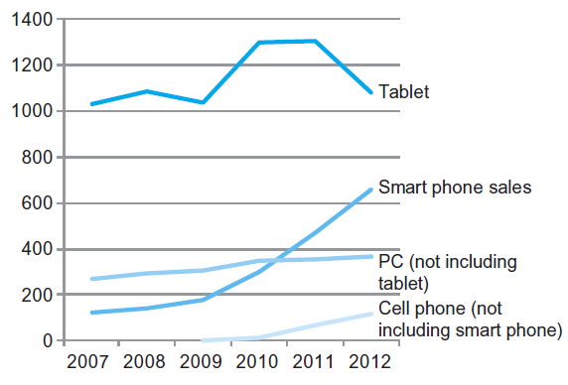
The PostPC Era
Notes:
Now there’s smartwatches too…

Slide 17
The PostPC Era
Personal Mobile Device (PMD)
Battery operated
Connects to the Internet
Hundreds of dollars
Smart phones, tablets, smart watches
Cloud computing
Warehouse Scale Computers (WSC)
Software as a Service (SaaS)
Portion of software run on a PMD and a portion run in the Cloud
Amazon and Google
Notes:
Q: What is cloud computing?
A: Just somebody else’s computer!
Weirdly enough, this is a return to the early days of computing, 50s-70s, where dumb terminals connected to a mainframe.

Slide 18
What You Will Learn
How programs are translated into the machine language
And how the hardware executes them
The hardware/software interface
What determines program performance
And how it can be improved
How hardware designers improve performance
What is parallel processing
Notes:
HW/SW Interface: HW promises these particular things it can do, with certain behaviors. Compiler takes high-level software and converts it down to use the hardware interface.

Slide 19
Understanding Performance
Algorithm (and sometimes OS)
Determines number of operations executed
Programming language, compiler, architecture
Determine number of machine instructions executed per operation
Processor and memory system
Determine how fast instructions are executed
I/O system (including OS)
Determines how fast I/O operations are executed
Notes:
Really, 3 key parts to understanding performance of a ”high-level program”, e.g., C++: # operations, # machine instructions per op, and how fast instructions are executed.
But I/O operations usually take way longer, so we separate them into a fourth category.
“Operations” are high level things like “a = b + c;”, “x = foo();”, etc.

Slide 20
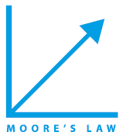

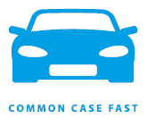




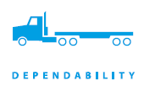
Eight Great Ideas
Design for Moore’s Law
Use abstraction to simplify design
Make the common case fast
Performance via parallelism
Performance via pipelining
Performance via prediction
Hierarchy of memories
Dependability via redundancy
§1.2 Eight Great Ideas in Computer Architecture
Notes:
Section 1.2
Common case is extremely important and probably the most transferable to other areas of life, IMO. There were always be too many things to do, e.g., too many parts of your program to make faster. Choose the part that’s used the most to fix.
Think of pipelining like an assembly line.

Slide 21
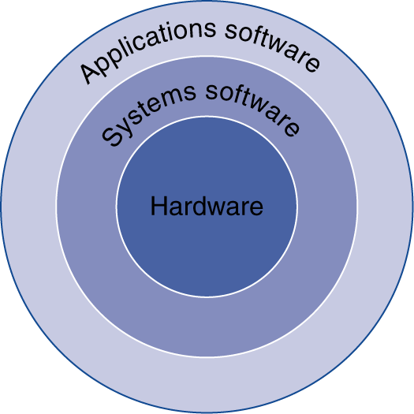
Below Your Program
Application software
Written in high-level language
System software
Compiler: translates HLL code to machine code
Operating System: service code
Handling input/output
Managing memory and storage
Scheduling tasks & sharing resources
Hardware
Processor, memory, I/O controllers
§1.3 Below Your Program
Notes:
Section 1.3
Gets even more complicated if you use an interpreted language like Python, Javascript, etc.

Slide 22
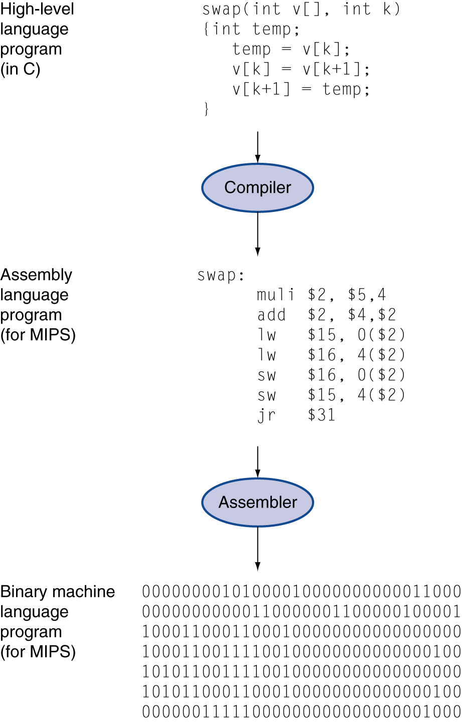
Levels of Program Code
High-level language
Level of abstraction closer to problem domain
Provides for productivity and portability
Assembly language
Textual representation of instructions
Hardware representation
Binary digits (bits)
Encoded instructions and data
Notes:
From our perspective, C is a high-level language. When other people talk about high-level, they really mean languages that handle a lot of stuff for you, e.g., Racket, Python, etc.
You have to break everything down to 0s and 1s, b/c that is fundamentally all that a computer can understand.

Slide 23
Notes:
Here’s what other people mean by high and low level.

Slide 24
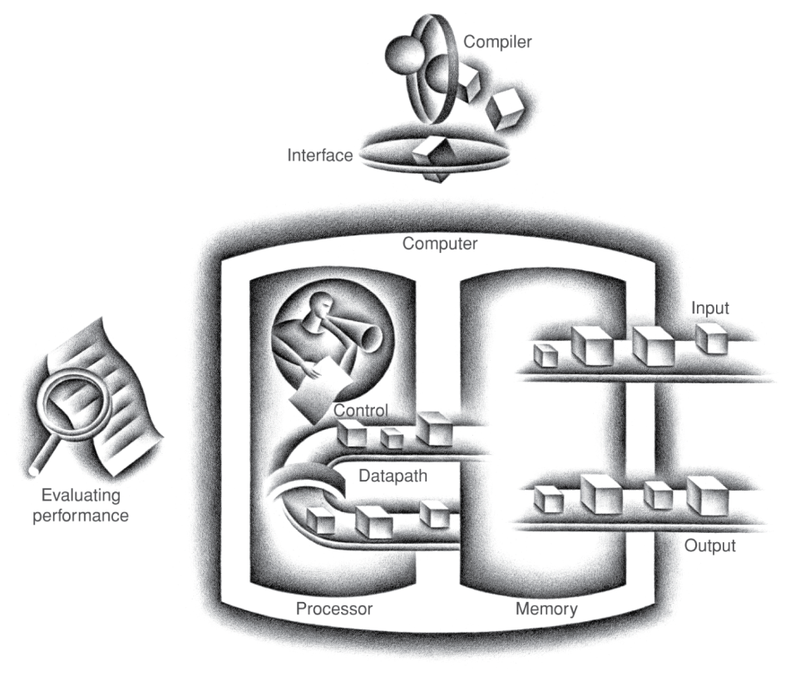
Components of a Computer
Same components for all kinds of computer
Desktop, server, embedded
Input/output includes
User-interface devices
Display, keyboard, mouse
Storage devices
Hard disk, CD/DVD, flash
Network adapters
For communicating with other computers
§1.4 Under the Covers
The BIG Picture
Notes:
Section 1.4

Slide 25
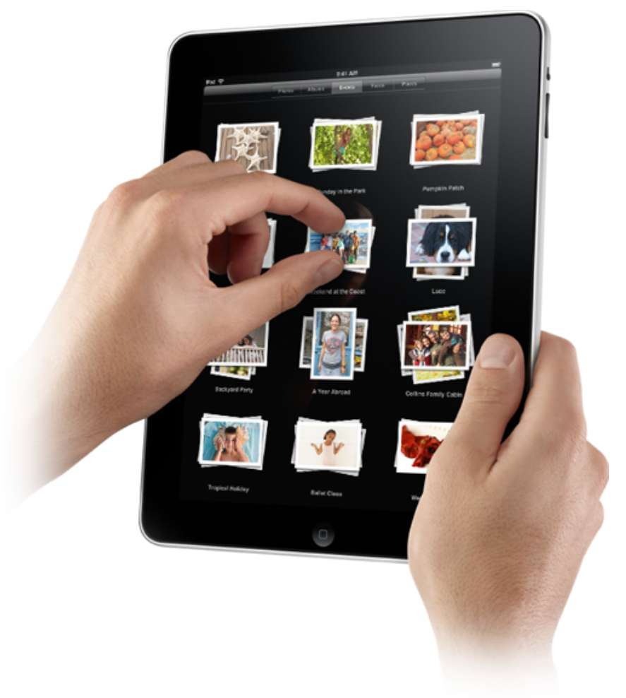
Touchscreen
PostPC device
Supersedes keyboard and mouse
Resistive and Capacitive types
Most tablets, smart phones use capacitive
Capacitive allows multiple touches simultaneously

Slide 26
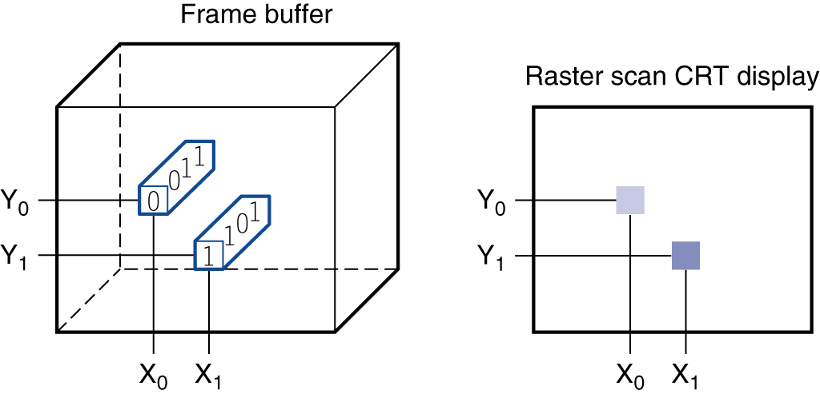
Through the Looking Glass
LCD screen: picture elements (pixels)
Mirrors content of frame buffer memory
Notes:
Book talks a little about this; it’s not that important for us…

Slide 27
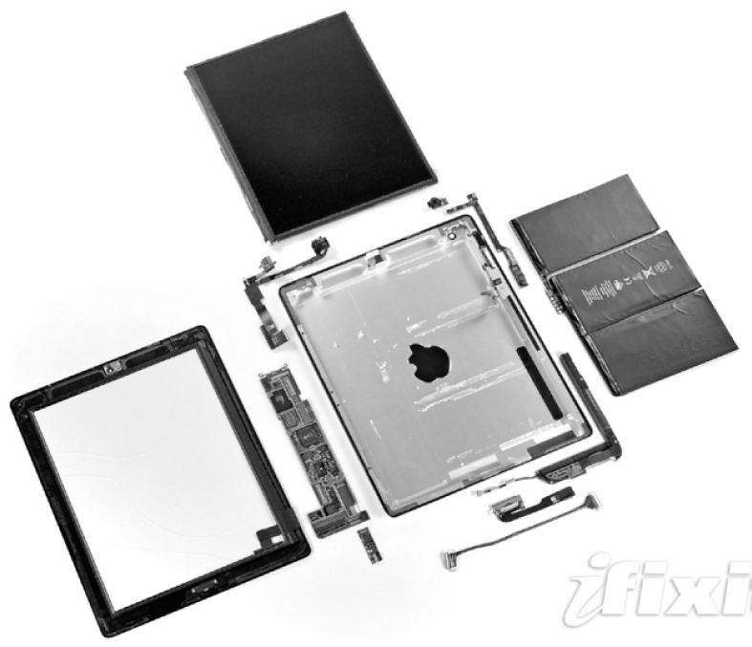
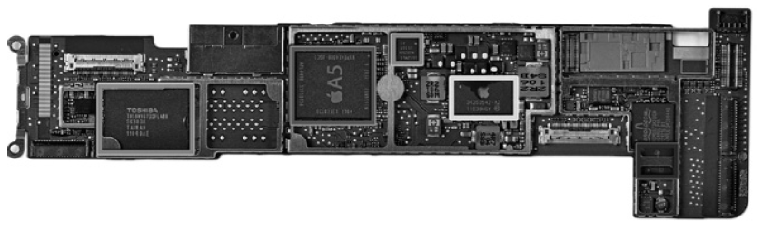
Opening the Box
Capacitive multitouch LCD screen
3.8 V, 25 Watt-hour battery
Computer board
Notes:
A5 is mostly what we care about. Other stuff is interfaces, memory, etc.

Slide 28
Inside the Processor (CPU)
Datapath: performs operations on data
Control: sequences datapath, memory, ...
Cache memory
Small fast memory for immediate access to data
Notes:
Control figures out what operation we need to do and how to do it,

Slide 29
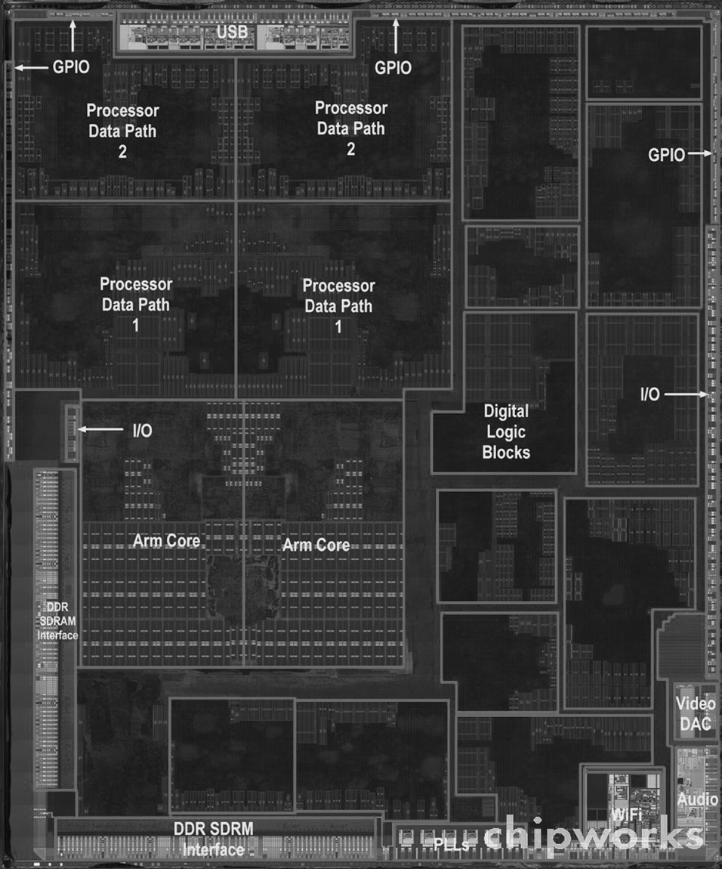
Inside the Processor
Apple A5

Slide 30
Abstractions
The BIG Picture
Abstraction helps us deal with complexity
Hide lower-level detail
Instruction set architecture (ISA)
The hardware/software interface
Application binary interface
The ISA plus system software interface
Implementation
The details underlying and interface
Notes:
Example of abstractions. Implementation example: lots of ARM chips, all use the same (or similar) ISA.

Slide 31
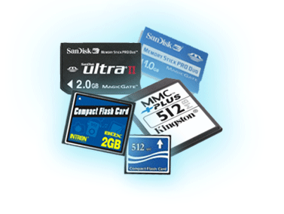
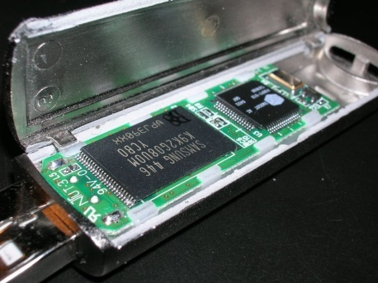
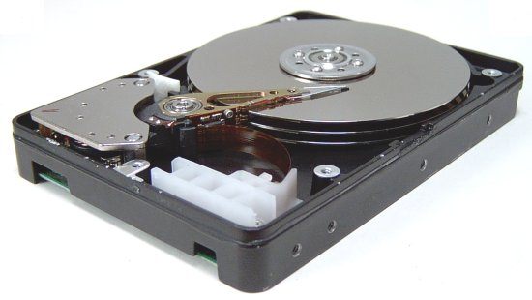
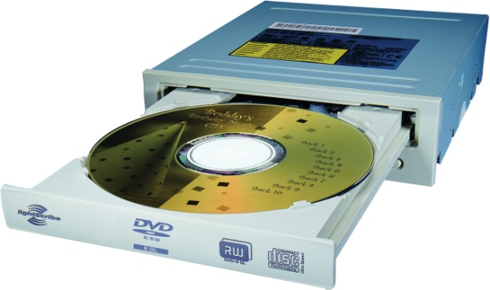
A Safe Place for Data
Volatile main memory (RAM)
Loses instructions and data when power off
Non-volatile secondary memory
Magnetic disk
Flash memory
Optical disk (CDROM, DVD)
Notes:
An increasingly important area of research: NVRAM

Slide 32
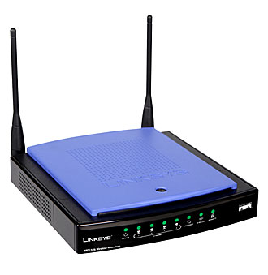
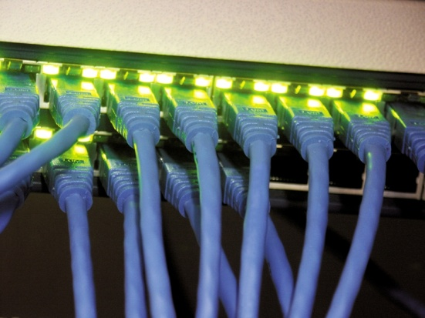
Networks
Communication, resource sharing, nonlocal access
Local area network (LAN): Ethernet
Wide area network (WAN): the Internet
Wireless network: WiFi, Bluetooth
Notes:
We won’t really talk about networks much.

Slide 33
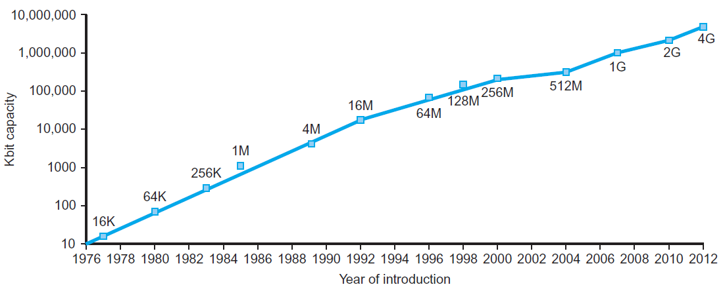
Technology Trends
Electronics technology continues to evolve
Increased capacity and performance
Reduced cost
§1.5 Technologies for Building Processors and Memory
DRAM capacity
Year | Technology | Relative performance/cost
1951 | Vacuum tube | 1
1965 | Transistor | 35
1975 | Integrated circuit (IC) | 900
1995 | Very large scale IC (VLSI) | 2,400,000
2013 | Ultra large scale IC | 250,000,000,000
Notes:
Section 1.5. Moore’s law is actually about transistors.

Slide 34
Semiconductor Technology
Silicon: semiconductor
Add materials to transform properties:
Conductors
Insulators
Switch
Notes:
Start with a big wafer of silicon, cut out parts of it, add stuff to do what we want. This is basically the only class I am going to talk about semiconductors…

Slide 35
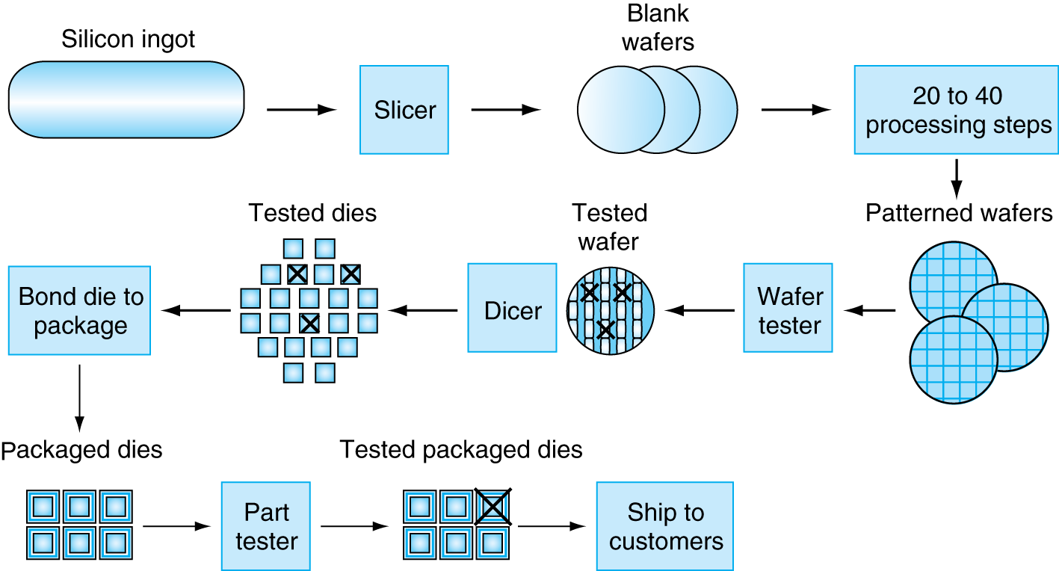
Manufacturing ICs
Yield: proportion of working dies per wafer
Notes:
The process is imperfect, so you get plenty of failed chips

Slide 36
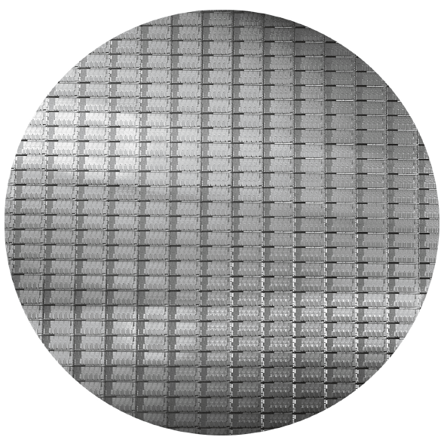
Intel Core i7 Wafer
300mm wafer, 280 chips, 32nm technology
Each chip is 20.7 x 10.5 mm

Slide 37
Integrated Circuit Cost
Nonlinear relation to area and defect rate
Wafer cost and area are fixed
Defect rate determined by manufacturing process
Die area determined by architecture and circuit design

Slide 38
Summary
Syllabus
Moore’s Law
Classes of Computers
Performance of a Computer
Components of a Computer

Slide 39
What I want you to do
Install Socrative
Read/review chapter 1
Enjoy the new semester!

